Slide 1
Graduate School
Your Next Step...
Allison Peterson, MS Ed.
Manager, Career Services
Bon Secours Memorial College of Nursing

Slide 2
Thinking about your education
It’s exciting that you are beginning to explore graduate nursing education.
You might begin by asking yourself a few questions about your goals…

Slide 3
Goals…
What can I do with an advanced degree that I cannot accomplish without it?
What type of job do I hope to have after completing the program?

Slide 4
Research
Research should start with yourself.
Where do I see myself in my nursing practice?
Which fields of nursing are growing the fastest?
Which types of patients am I drawn to?
What type of work setting do I thrive in?
What schedule will work for me and my family?
What are my financial needs/goals?

Slide 5
Finding Answers
Talk
Talk to nurses – those performing the role you aspire to.
Go
Go on-line to learn about these nursing professions.
Be
Be sure to apply to programs that will align with your career objectives.
Check out
Check out some of the links at the end of this slide show.

Slide 6
Finding Answers
Talk to faculty at your nursing school, alumni, and colleagues
Attend an Information Session or On-line Chat to ask questions about the programs that interest you
Contact the Graduate Nursing School Office of Admissions

Slide 7
Course Delivery
Consider how the nursing program is offered:
on-line
on campus
in a hybrid (blended) format
Will that work for you and your family?

Slide 8
Costs
Consider:
Tuition
Federal Financial aid
Your employer's tuition assistance program
Loans & employer-sponsored loan repayment plans
Scholarships (the financial aid office at the colleges you are exploring can help)
Can you continue to work full or part-time?
Transportation/housing if travel is required to attend
Childcare - if travel required

Slide 9
Clinical Components
Will your current job meet the clinical requirements of the degree?
If not, will the program arrange the clinical site or are you responsible for doing so? (This can be difficult to do. We advise you to understand this thoroughly before enrolling.)

Slide 10
Accreditation
Is the college you are considering accredited by a national or regional accrediting agency under the Council for Higher Education Accreditation (www.chea.org)?
Is the nursing program recognized by the Commission on Collegiate Nursing Education?

Slide 11
Success Rates & Costs
What is the success rate of graduates on the licensing exam for the program you are exploring? (Example: what % of graduates successfully pass the NP licensure exam?)
Reputable, established institutions are proud of their accreditation and success rates. This information is often prominently featured on their web site.

Slide 12
Narrowing Down Your Choices
Once you’ve narrowed down the colleges you plan to apply to that offer the degree you seek, there are a number of time-sensitive steps to complete…

Slide 13
Admission Requirements
When is the application due?
How about a personal statement? Many college career centers serve alumni by proofreading resumes and personal statements/essays. (I will do this for you!)
Request official transcripts from undergraduate programs

Slide 14
Admission Requirements
Contact prospective references and update them about your plans.
Ask if they would be willing to provide a reference for you.
Provide references plenty of time (3-4 weeks) and give them clear directions about where to mail / email the reference. (Some colleges send references out electronically directly to the person you indicate).

Slide 15
Do You Need to Take the GRE?
Is the GRE (Graduate Record Exam) required? If so, begin studying and schedule the test.
GRE Exam: https://www.ets.org/gre.html

Slide 16
Follow Up
Follow up with your top choice programs to stay on track of admission deadlines.
Ask which of your documents are still needed.

Slide 17
Decisions…..
If you are accepted to a graduate program, respond by the deadline.
Write "thank you" notes to your references.
If you are declining an offer of acceptance, contact the Graduate Admissions Office to thank them.

Slide 18
Persisting …
If you were not accepted, see if you can determine the reasons. Sometimes, the graduate admissions officer can give you some idea.
Continue to explore options and apply with other programs.

Slide 19
Learn More about
Advance Practice Nursing Careers
American Association of Nurse Practitioners www.aanp.org
National League for Nursing— www.nln.org
The federal government’s Occupational Outlook Handbook
http://www.bls.gov/ooh/healthcare/nurse-anesthetists-nurse-midwives-and-nurse-practitioners.htm
The Virginia Council of Nurse Practitioners http://www.vcnp.net/

Slide 20
A Sample of Graduate Nursing Programs
Virginia Commonwealth University:
https://nursing.vcu.edu/
University of Virginia:
https://www.nursing.virginia.edu/academics/msn/
George Mason University: DNP
https://catalog.gmu.edu/colleges-schools/health-human-services/nursing/nursing-dnp/
George Mason University Online Nurse Educator MSN:
https://masononline.gmu.edu/programs/nursing-nurse-educator-concentration-msn/
George Washington University: https://nursing.gwu.edu/master-science-nursing

Slide 21
Emory University: https://www.nursing.emory.edu/
Liberty University Online:
https://www.liberty.edu/online/nursing/
Old Dominion University:
https://www.odu.edu/nursing/graduate
James Madison University –
https://www.nursing.jmu.edu/msn/index.html
Radford University: Doctor of Nursing Practice http://www.radford.edu/content/wchs/home/nursing/programs/dnp.html
Georgetown University: https://nursing.georgetown.edu/prospective-students/
To conduct a national search of graduate programs, visit www.gradschools.com

Slide 22
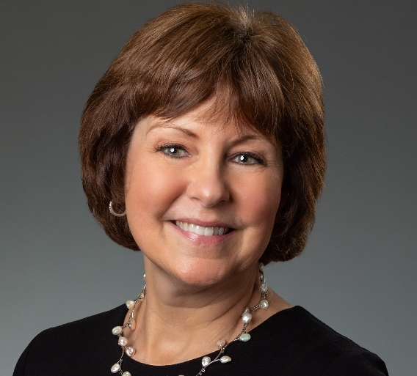
Contact me
Contact me if you’d like help, especially in writing your personal statement!
Allison_Peterson @ bshsi.org

